Slide 1

Introduction to Data Science
Topic:- Exploratory Data Analysis
By : aman singh

Slide 2


Abstract
Introduction
Dataset
Exploratory Data Analysis/Preprocessing
Feature Engineering
Visualization
Results
Conclusion
References
GitHub Repository for Code(optional)

Slide 3
Abstract
Exploratory Data Analysis (EDA) is a fundamental step in the data science workflow that involves the initial investigation of data to discover patterns, detect anomalies, test hypotheses, and check assumptions through summary statistics and graphical representations. By employing various statistical tools and visualization techniques, EDA enables analysts to understand the underlying structure of the data, identify significant variables, and uncover relationships between them. This process is crucial for guiding subsequent data processing, feature engineering, and model selection in machine learning projects. EDA not only enhances the quality and efficiency of data-driven decision-making but also ensures that the insights derived are robust and reliable. Through systematic exploration, EDA lays the groundwork for building predictive models that accurately reflect the complexities of real-world data.

Slide 4
Introduction
﻿﻿Exploratory Data Analysis is an approach to analyze the datasets to summarize their main characteristics in form of visual methods.
﻿﻿EDA is nothing but a data exploration technique to understand various aspects of the data.
﻿﻿The main aim of EDA is to obtain confidence in a data to an extent where we are ready to engage a machine learning model.
﻿﻿EDA is important to analyze the data it's a first steps in data analysis process.
﻿﻿EDA give a basic idea to understand the data and make sense of the data to figure out the question you need to ask and find out the best way to manipulate the dataset to get the answer to your question.
﻿﻿Exploratory data analysis help us to finding the errors, discovering data, mapping out data structure, finding out anomalies.
﻿﻿Exploratory data analysis is important for business process because we are preparing dataset for deep thorough analysis that will detect you business problem.
﻿﻿EDA help to build a quick and dirty model, or a baseline model, which can serve as a comparison against later models that you will build.

Slide 5
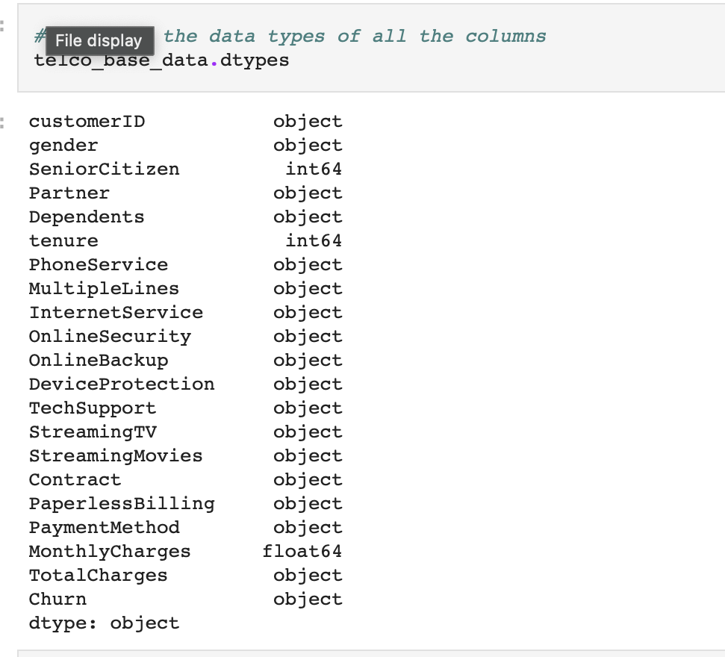
Dataset

Slide 6
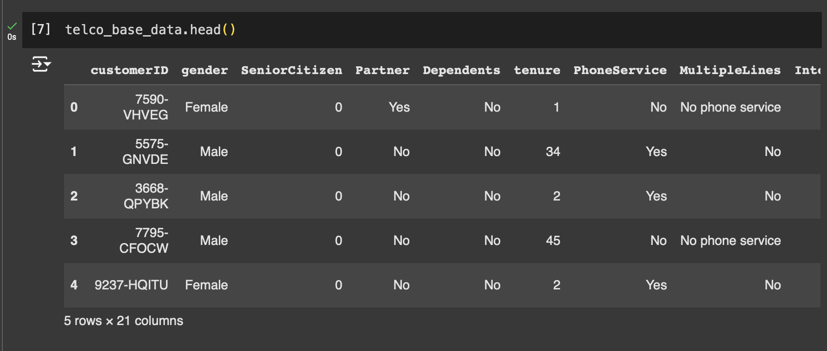
Head of the dataset

Slide 7
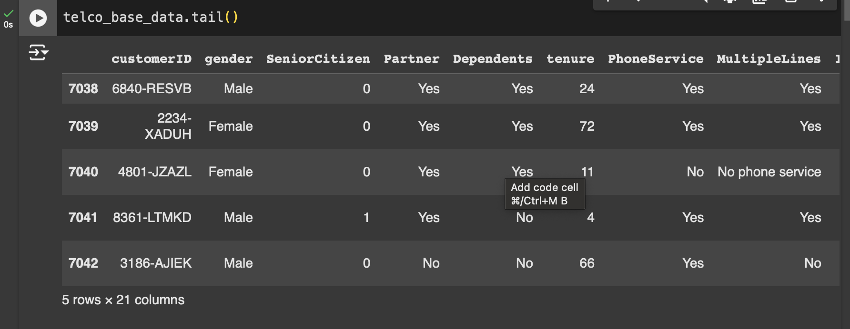
Tail of the dataset

Slide 8
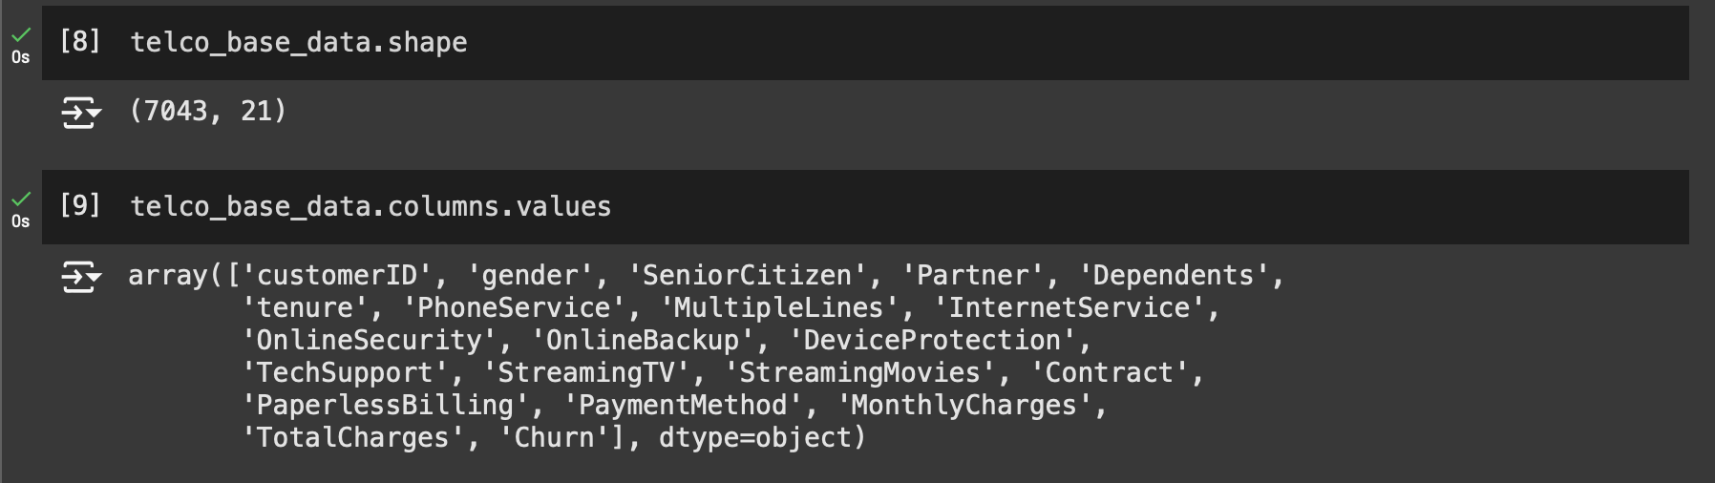
Data shape and columns values

Slide 9
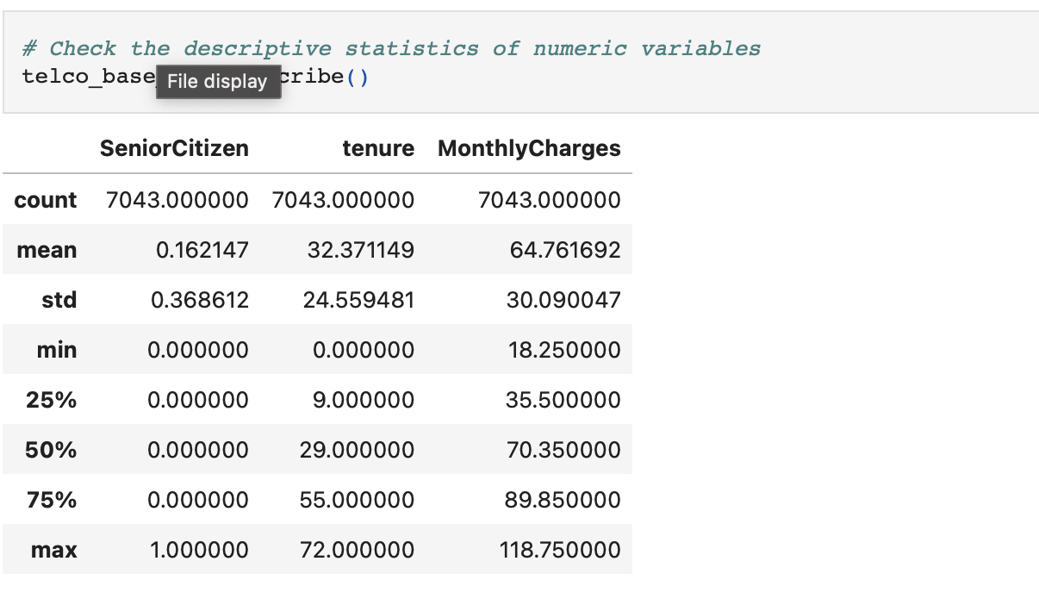

STATISTICS OF NUMERIC VARIABLES

Slide 10
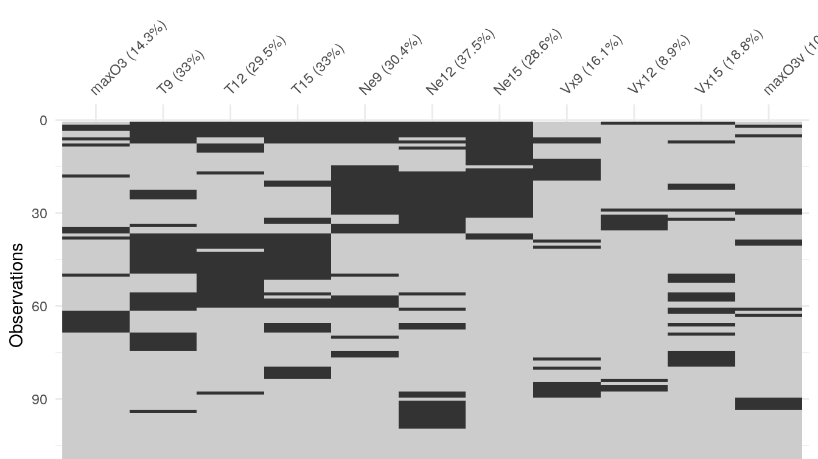
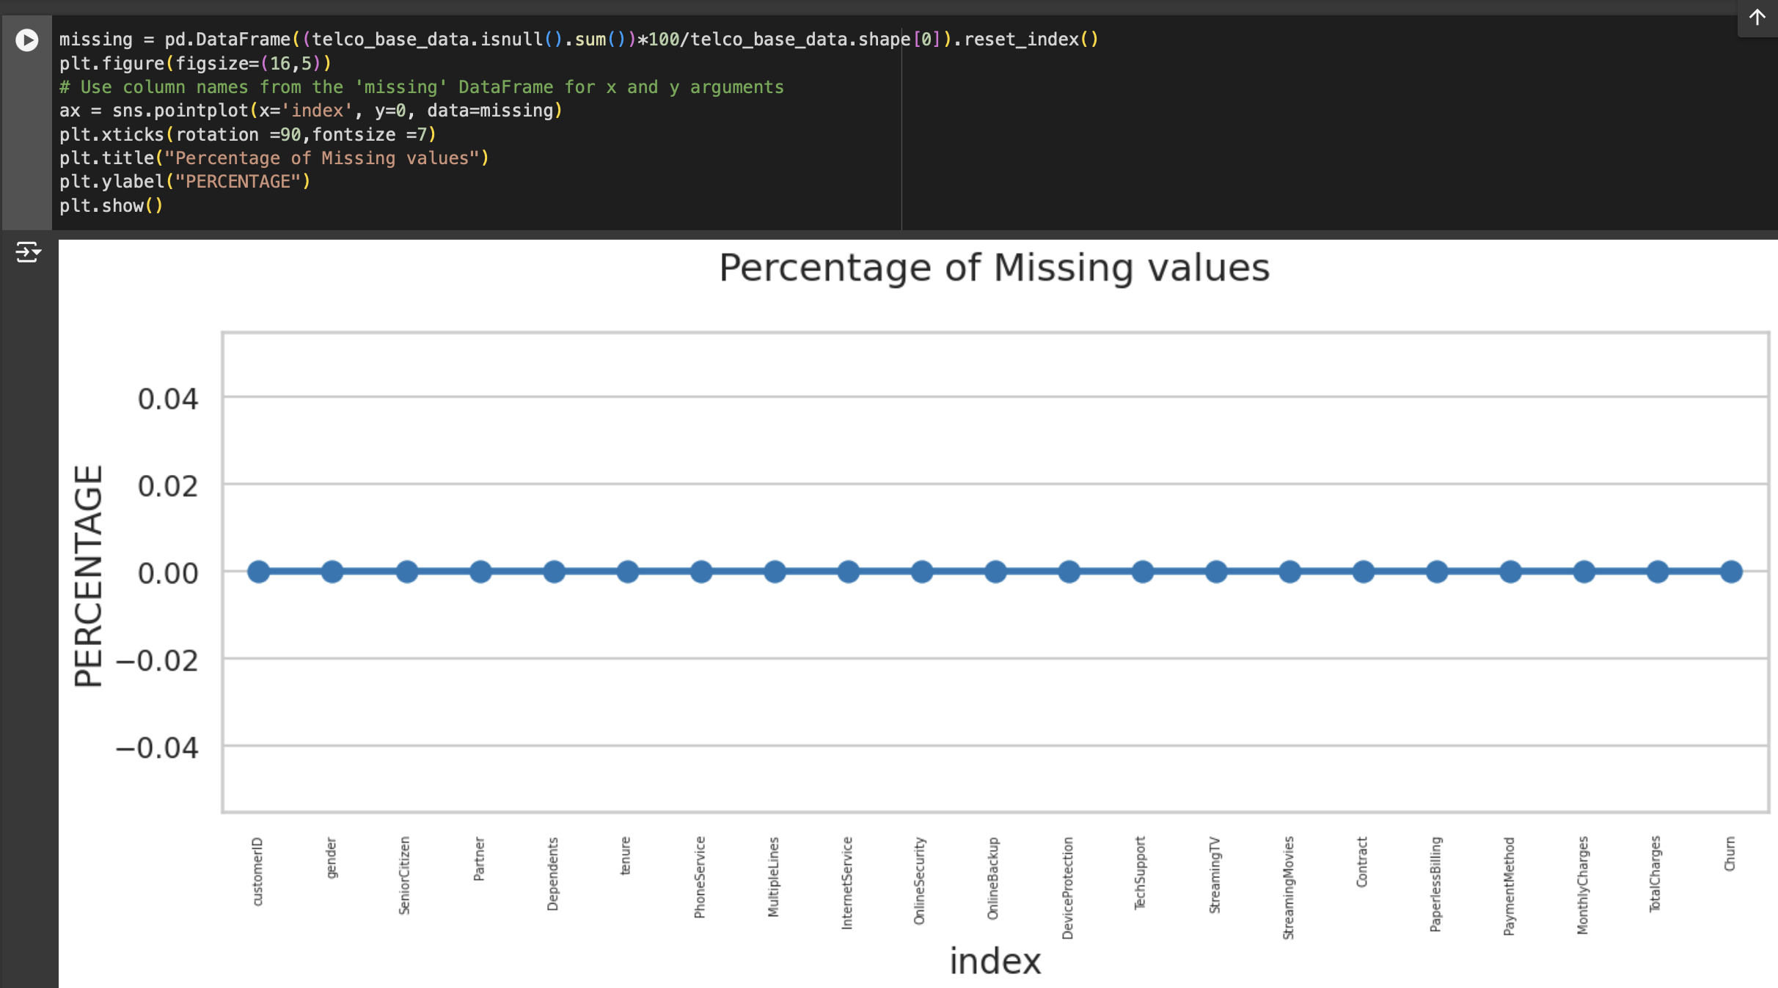
Checking missing values
This Photo by Unknown Author is licensed under CC BY-NC-ND

Slide 11
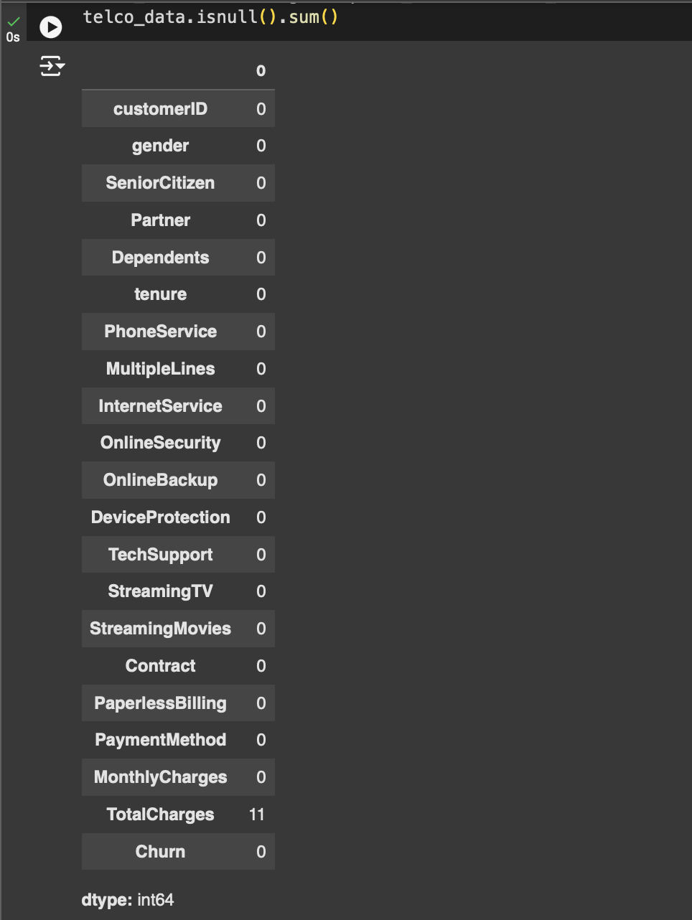
Checking null values

Slide 12
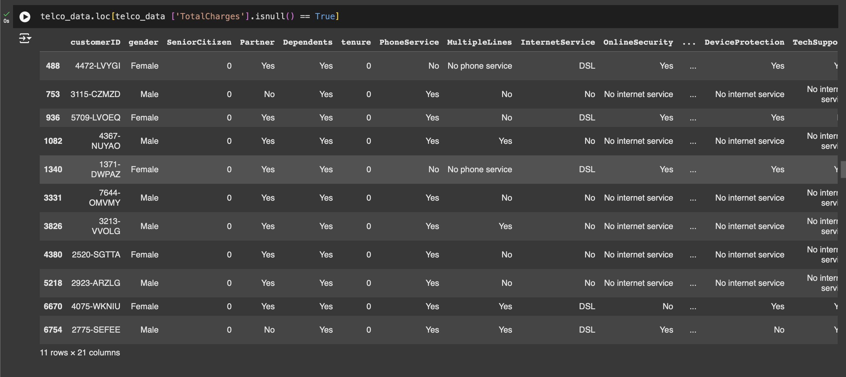

Slide 13
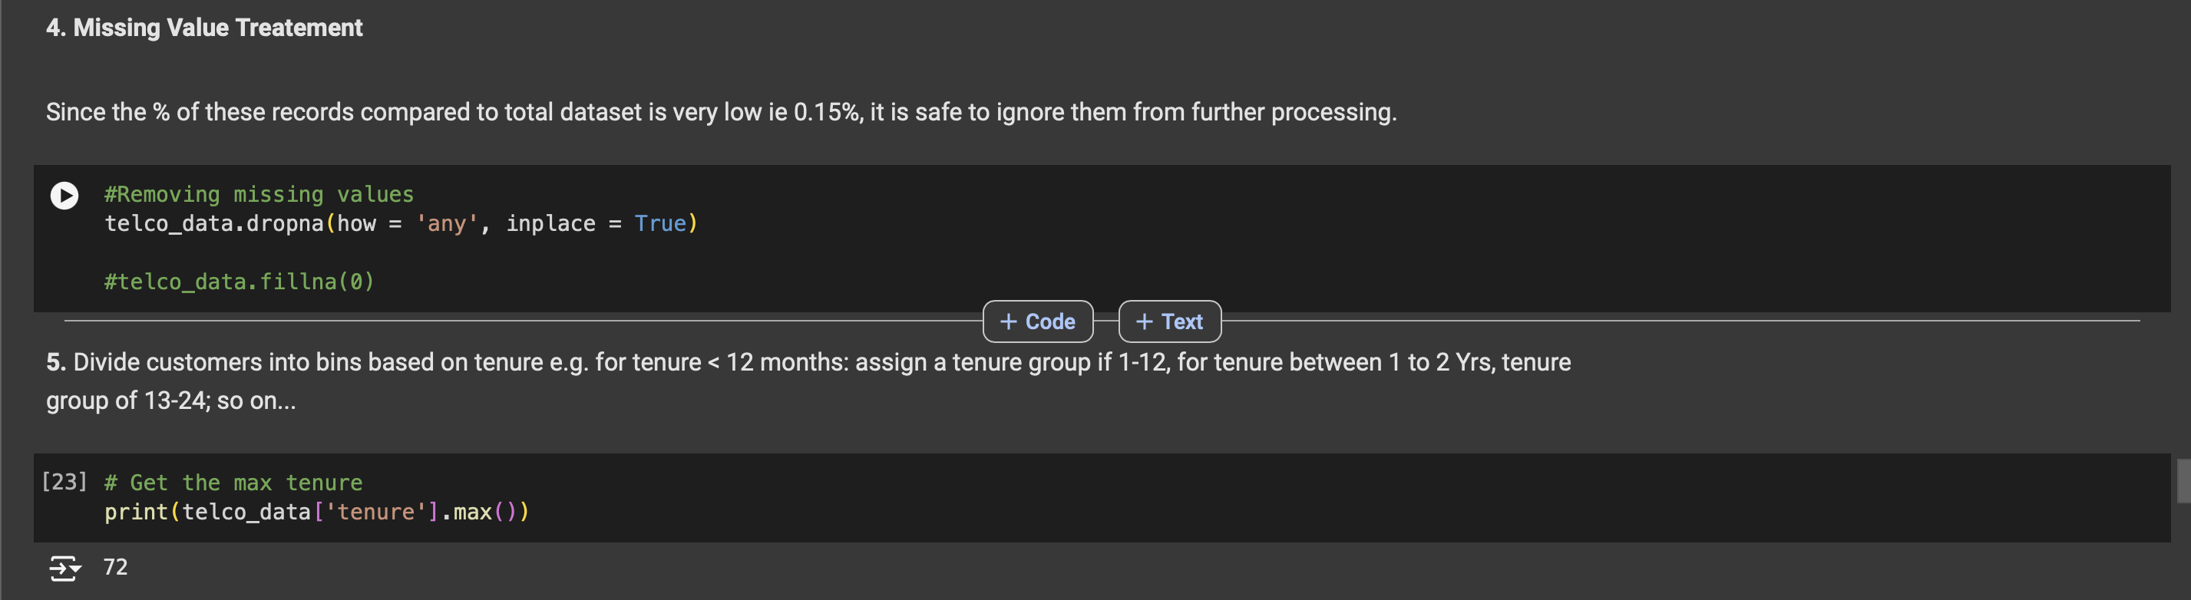
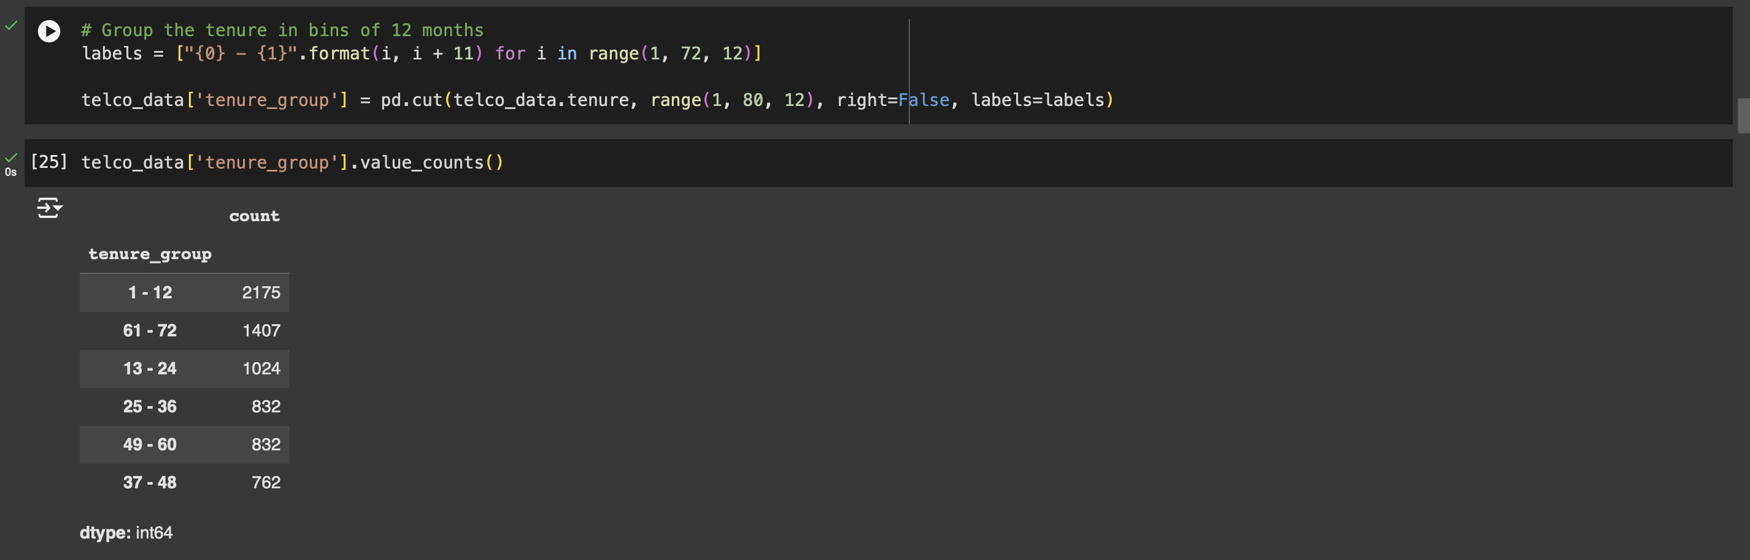

Slide 14
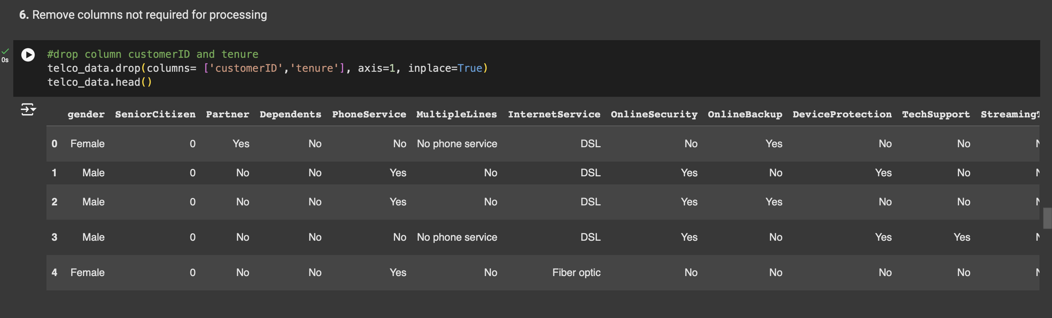
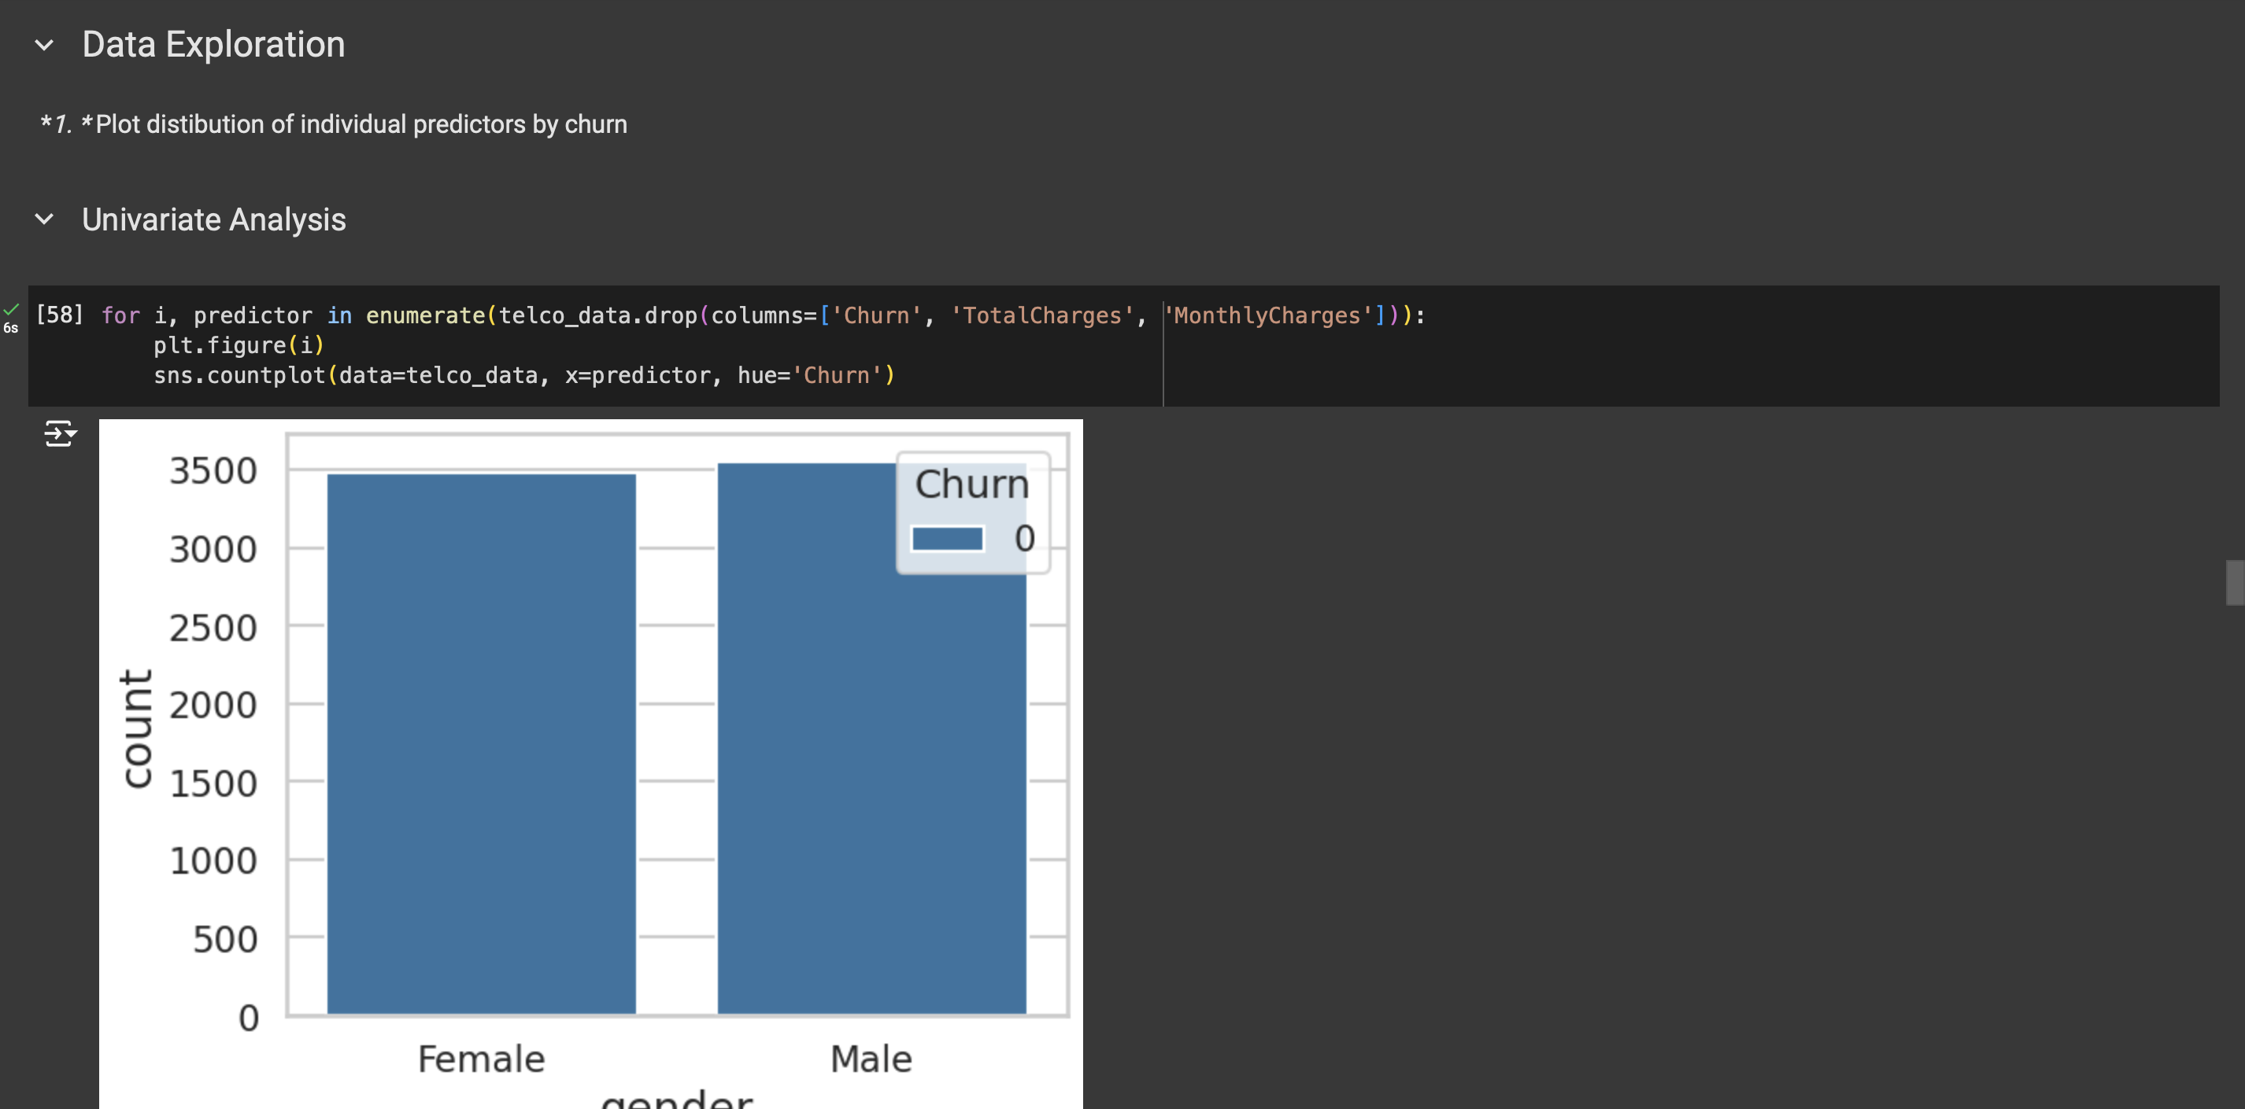

Slide 15
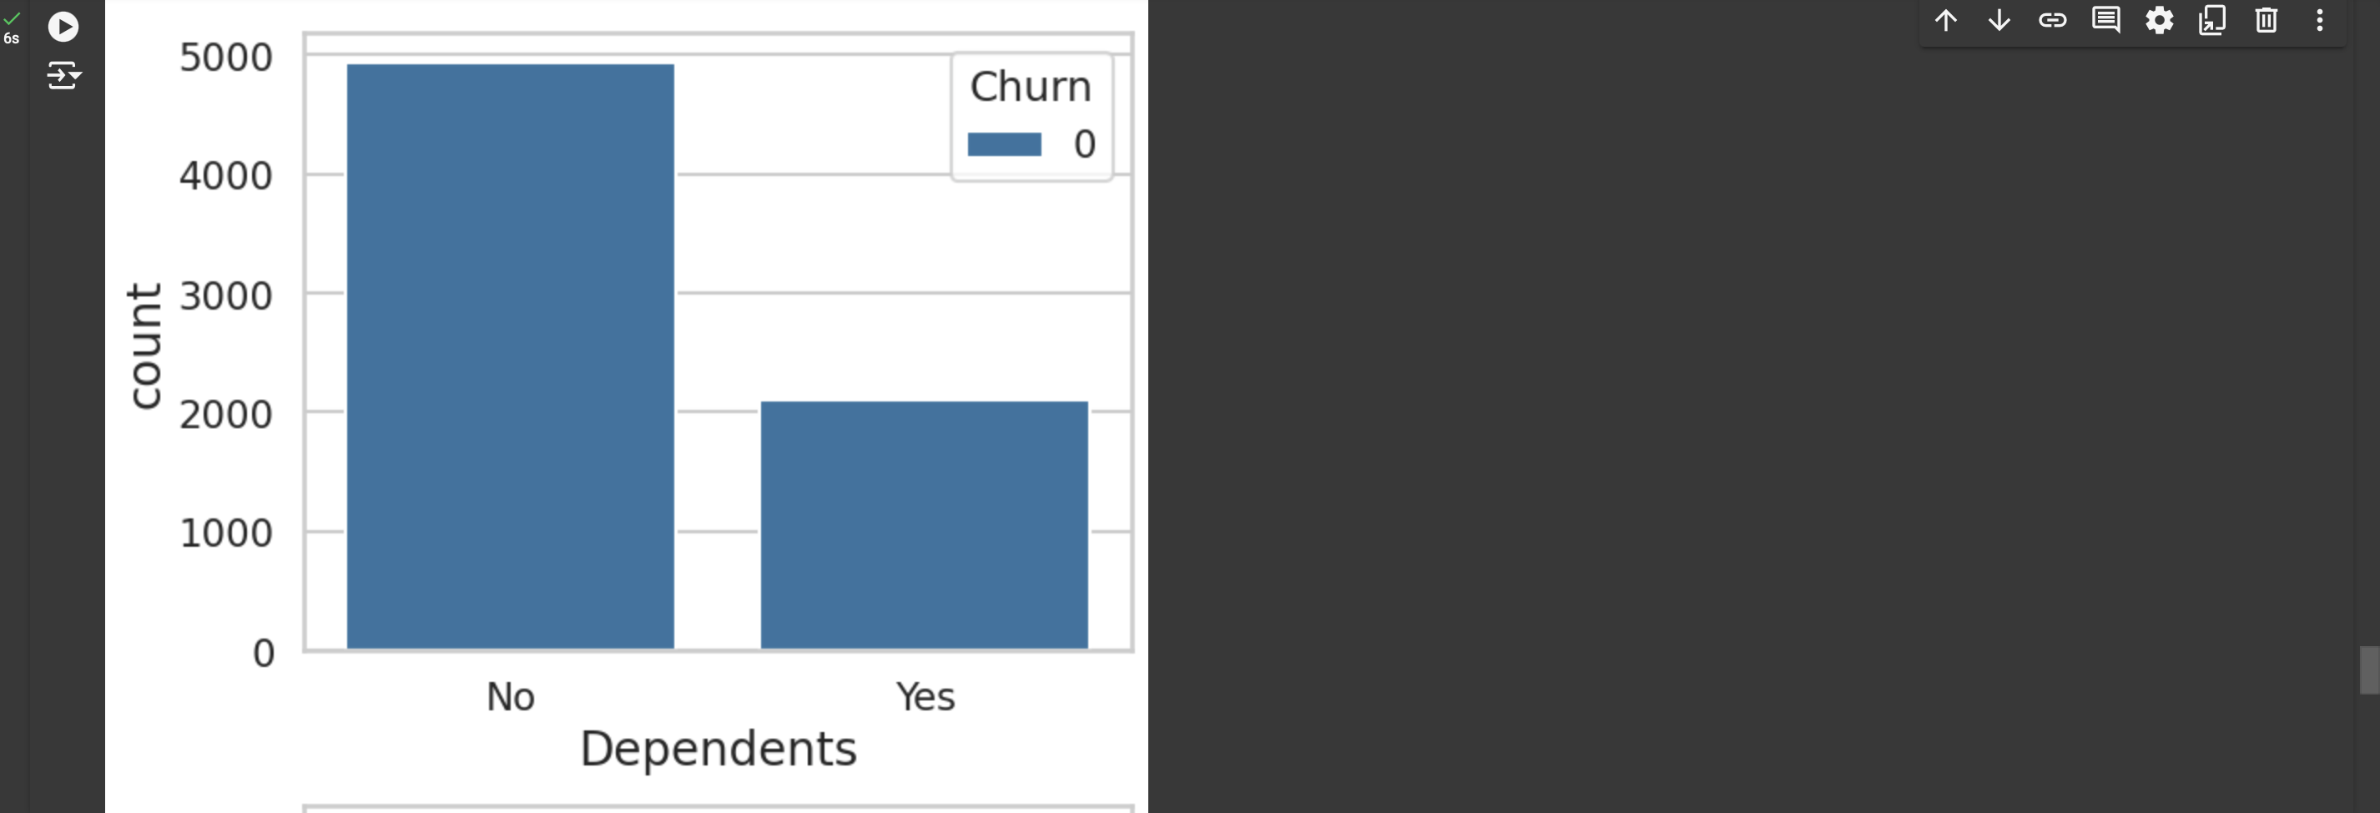
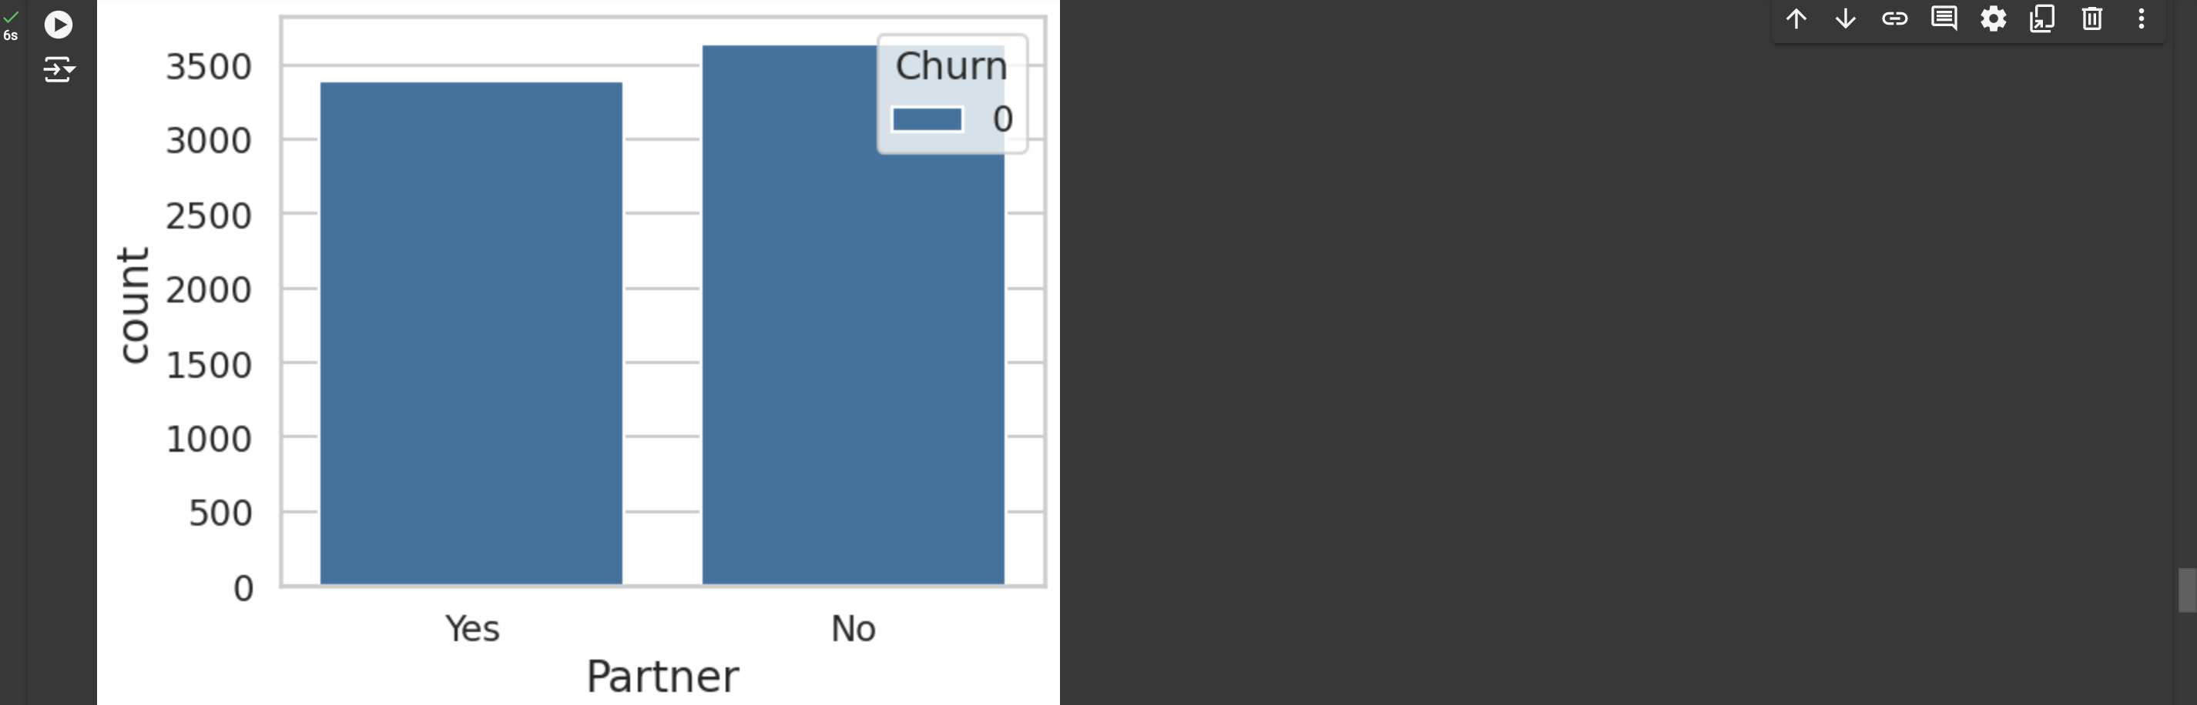

Slide 16
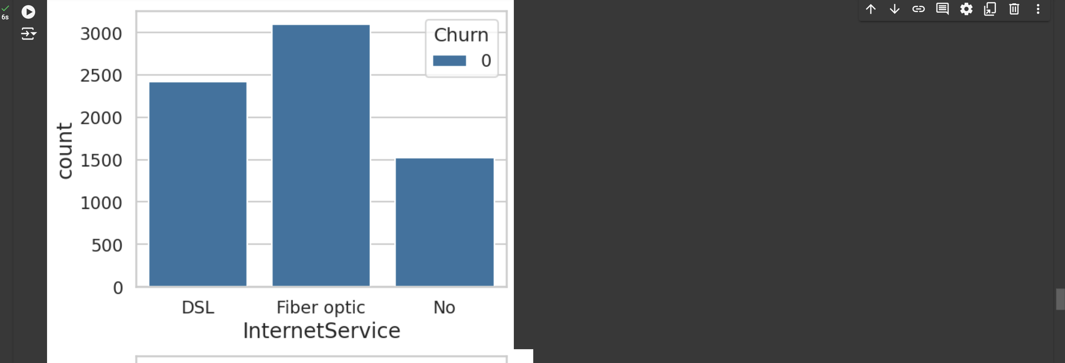
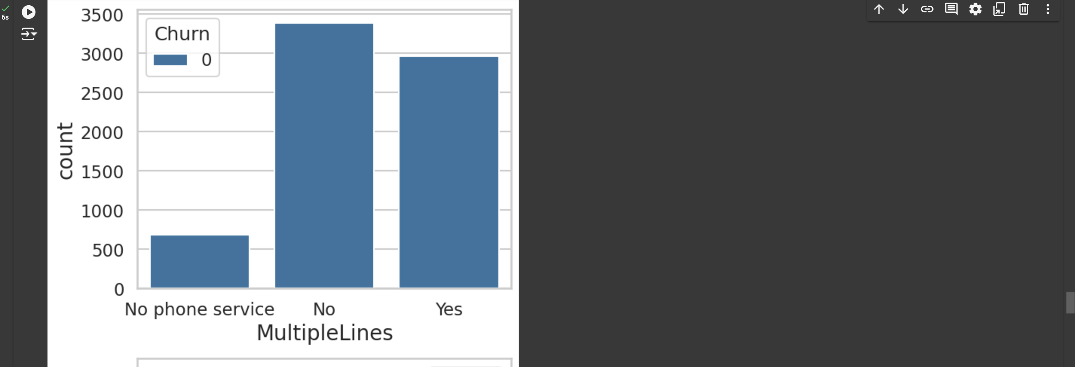

Slide 17
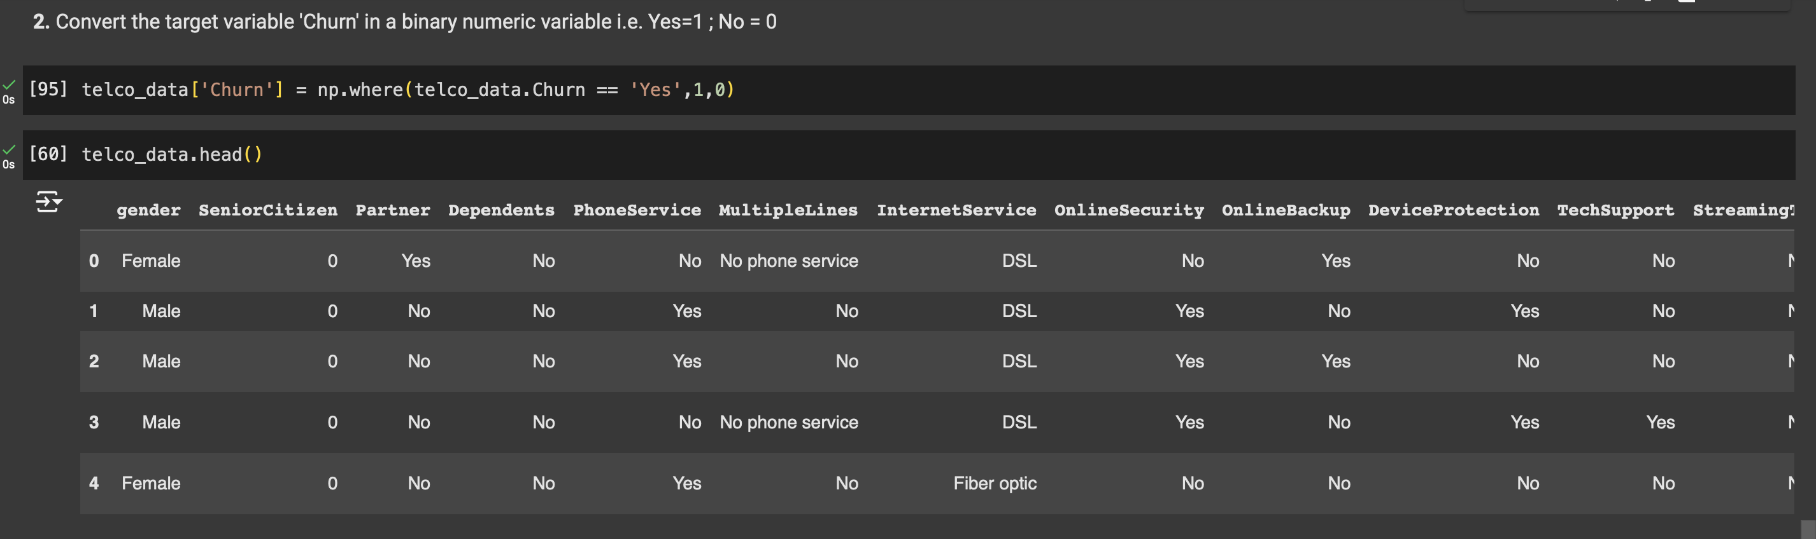
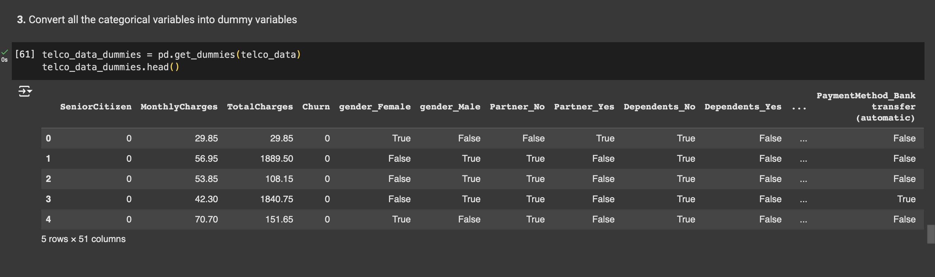

Slide 18
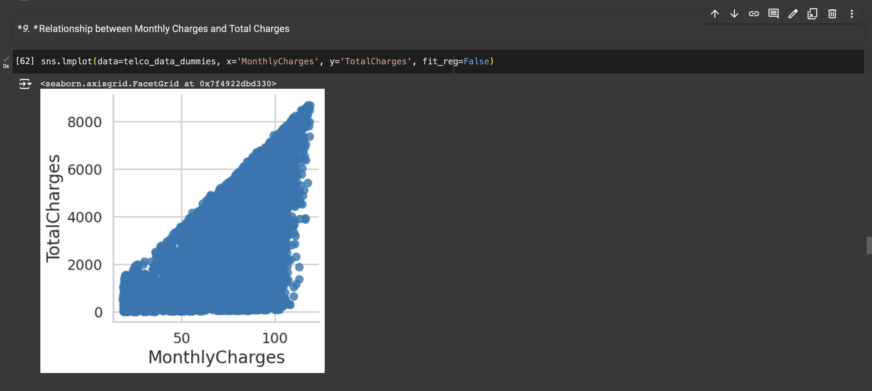
Seaborn plot

Slide 19
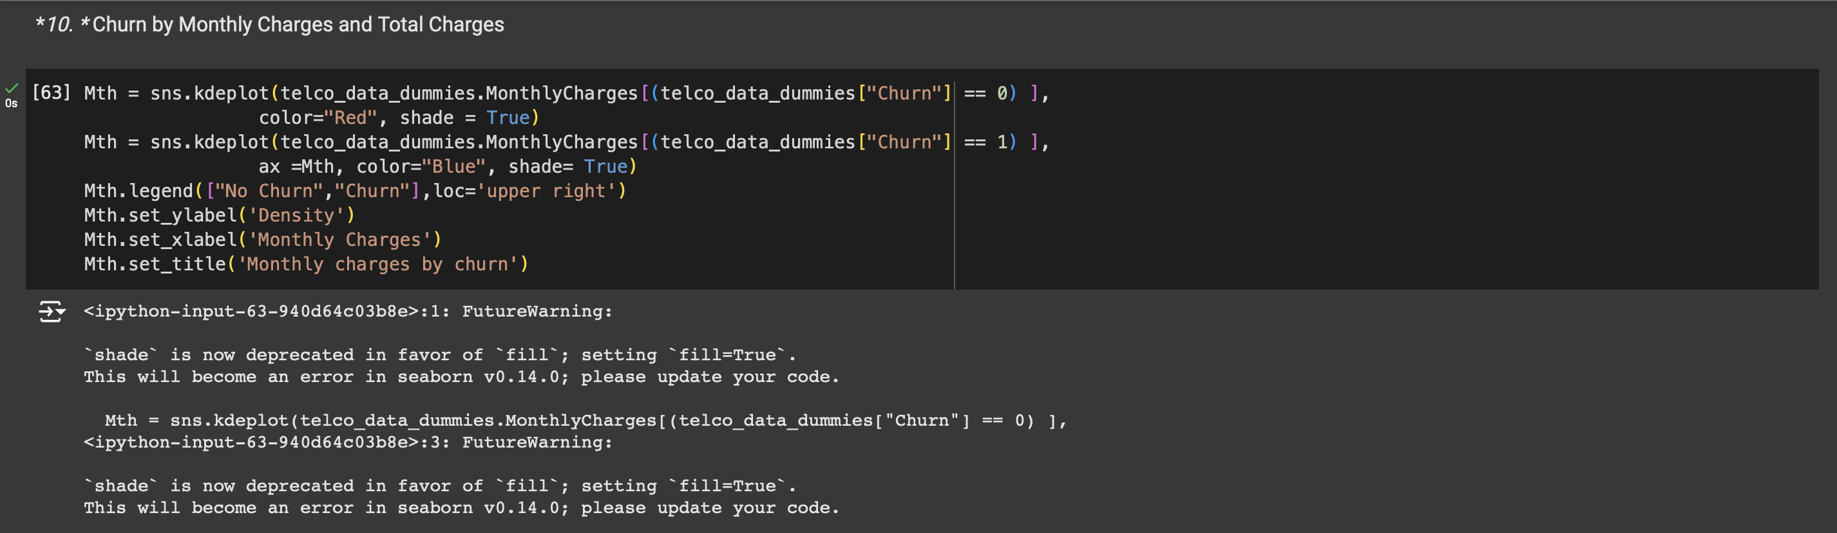
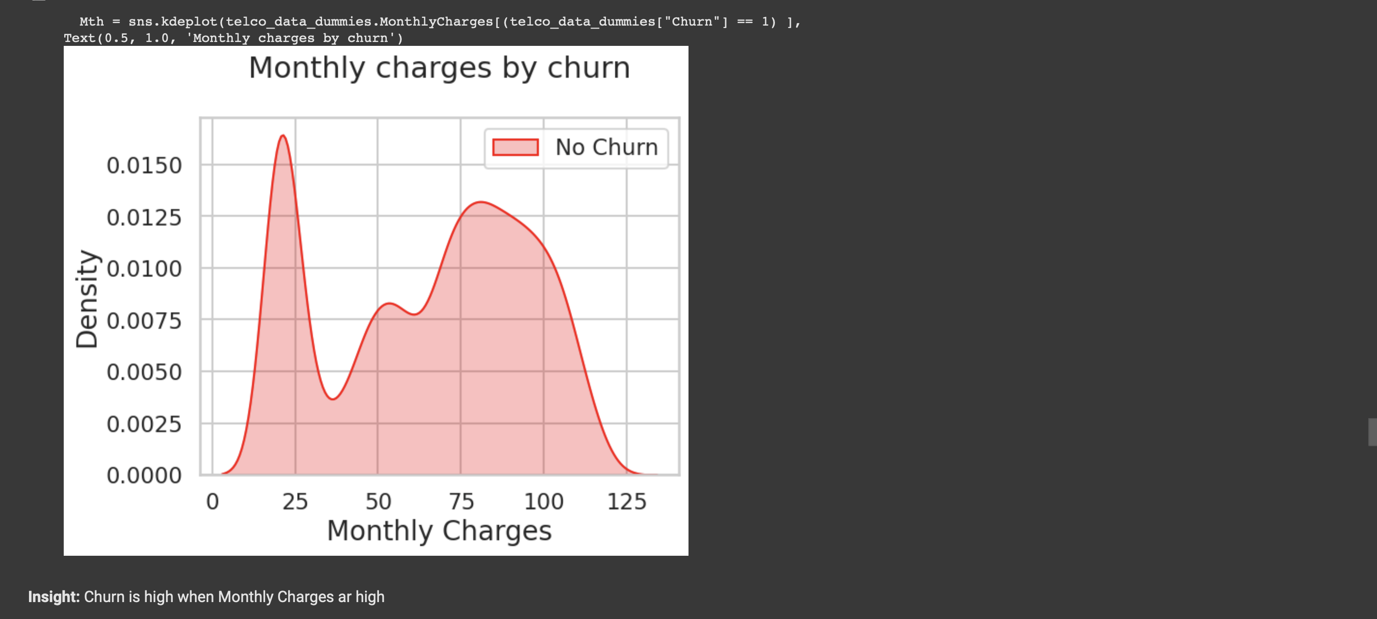

Slide 20
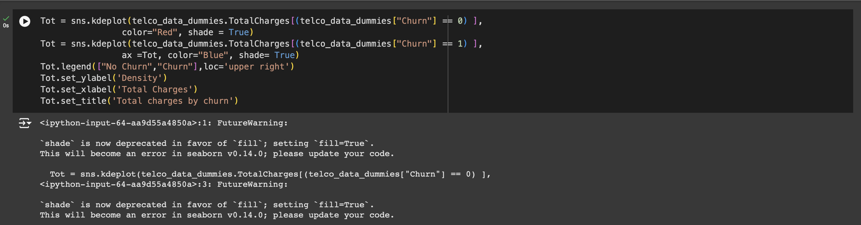
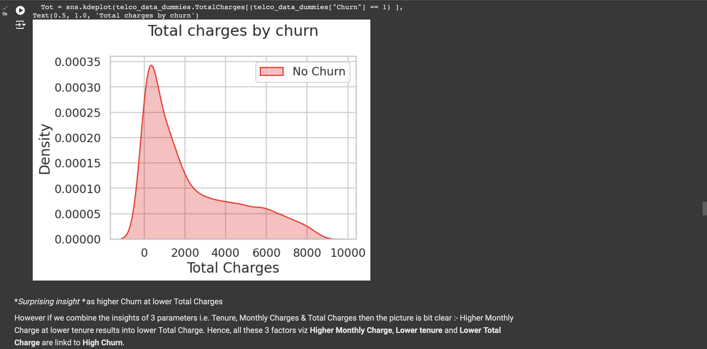

Slide 21
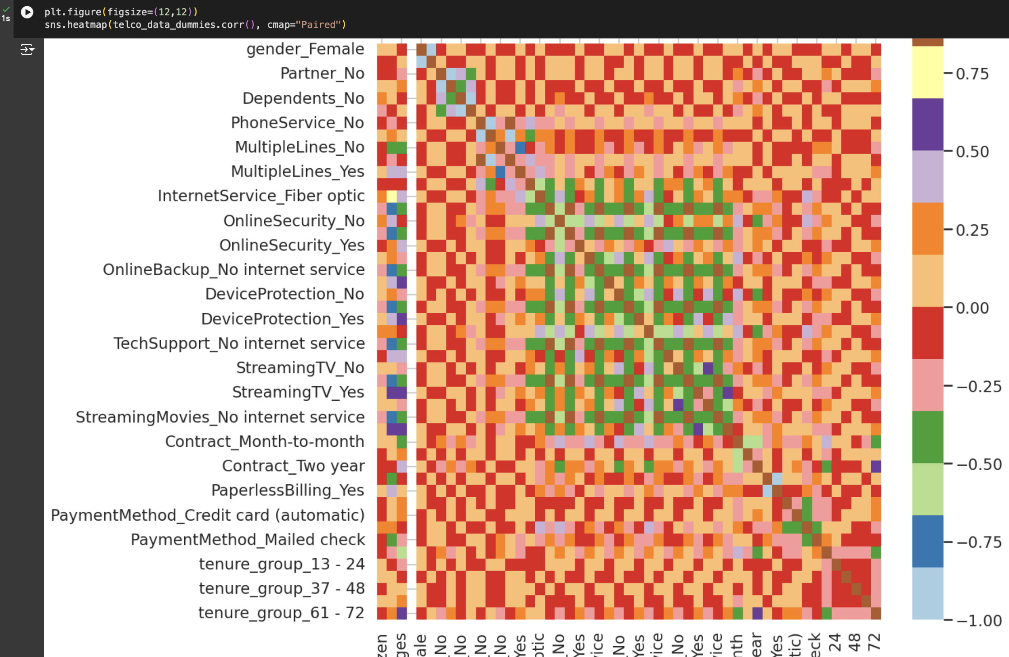
heatmap

Slide 22

conclusion
These are some of the quick insights from this exercise:
Electronic check medium are the highest churners
Contract Type - Monthly customers are more likely to churn because of no contract terms, as they are free to go customers.
No Online security, No Tech Support category are high churners
Non senior Citizens are high churners

Slide 23

References
Note: There could be many more such insights, so take this as an assignment and try to get more insights :)
telco_data_dummies.to_csv('tel_churn.csv')

Slide 24


